Slide 1
CAPSTONE PROJECT 2025
Sugar, Spice, and Predictive Advice: Forecasting Diabetes Risk with Lifestyle and Health Data
By Amanda Dias-Jayasinghe

Slide 2
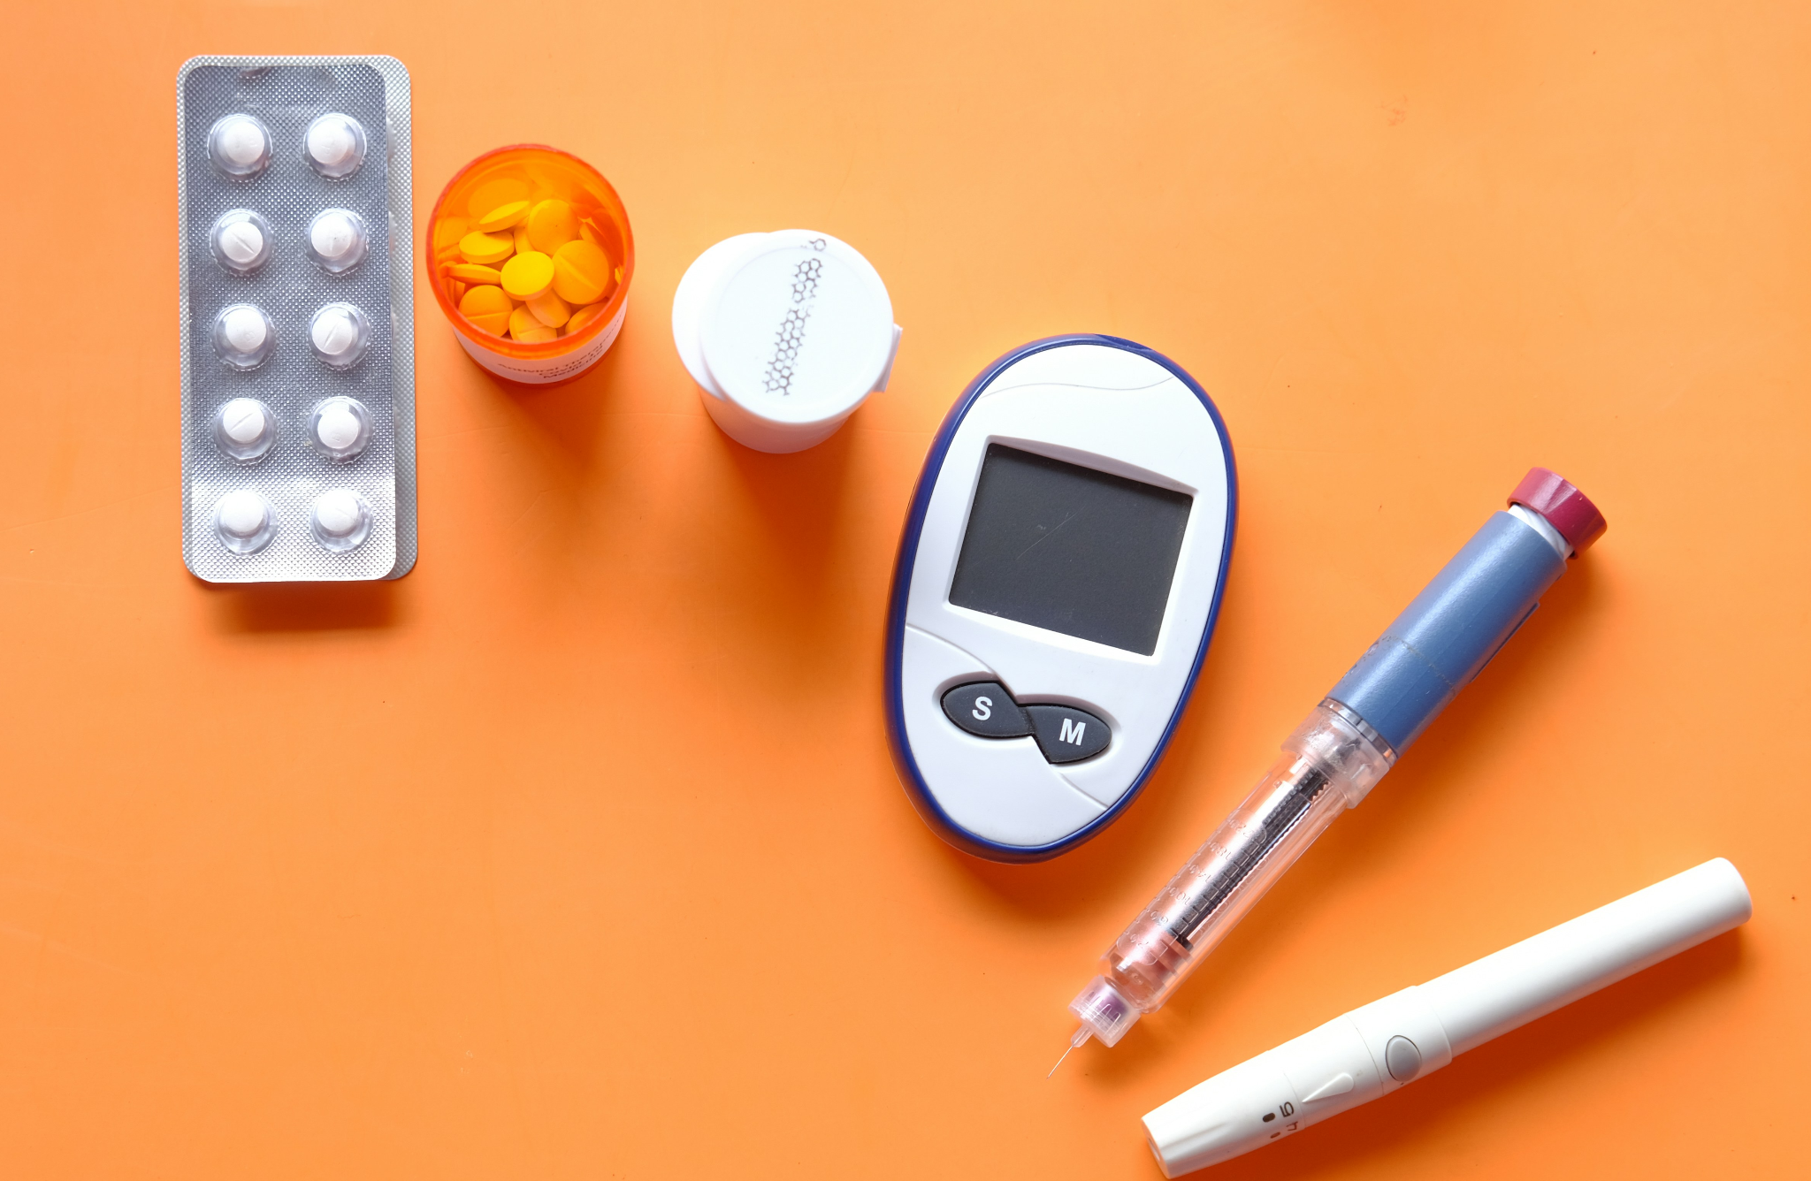


Contents
Part 1: Overview of project
Part 2: Model building and testing
Part 3: User demo
What is diabetes?
Aim of this project
Presentation of exploratory data analysis
Model building and selection of best model
Testing min and max model
Notes:
Image [1]- sourced from https://unsplash.com/
Image [2] [3] - generated by AI

Slide 3

Part 1:
Overview / exploring the dataset
Notes:
Image [4]- sourced from https://unsplash.com/

Slide 4
What is diabetes?
Diabetes occurs when the body doesn’t produce enough insulin or can’t use it effectively
Without proper insulin function, blood sugar stays high and can damage nerves, blood vessels, and other systems over time.
Different types of diabetes include: pre-diabetes, type 1, type 2 and gestational diabetes.
Type 1 is autoimmune and mostly genetic whereas, type 2 is largely linked to lifestyle factors.
Risk can be reduced or delayed through a healthy BMI, regular physical activity, a balanced diet, and avoiding tobacco.

Slide 5

Aim of this CAPSTONE project
In the uk:
Nearly ~ 1.8 million people living with undiagnosed type 2 diabetes [1]
According to WHO:
In 2021 - there were 1.6 million diabetes related deaths [2]
For this project, I am building a predictive machine learning model.
Diabetes is a major health issue, and current screening methods often identify the condition only after symptoms become more serious.
My goal is to use machine learning to recognise subtle patterns and early indicators that might otherwise be missed.
Notes:
Reference:
[1] https://www.diabetes.org.uk/about-diabetes/type-2-diabetes/preventing
[2] https://www.who.int/news-room/fact-sheets/detail/diabetes

Slide 6
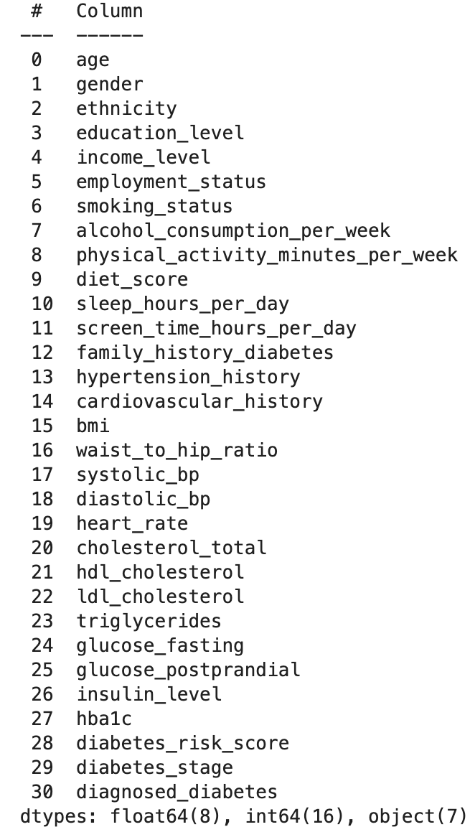
Exploratory data analysis
Kaggle ‘Diabetes health indicators dataset’ contains 10,000 patient records
Dataset includes features based on demographics, lifestyle habits, family history and clinical measurements
Columns contain mix of data types (integers, objects and floats)

Slide 7
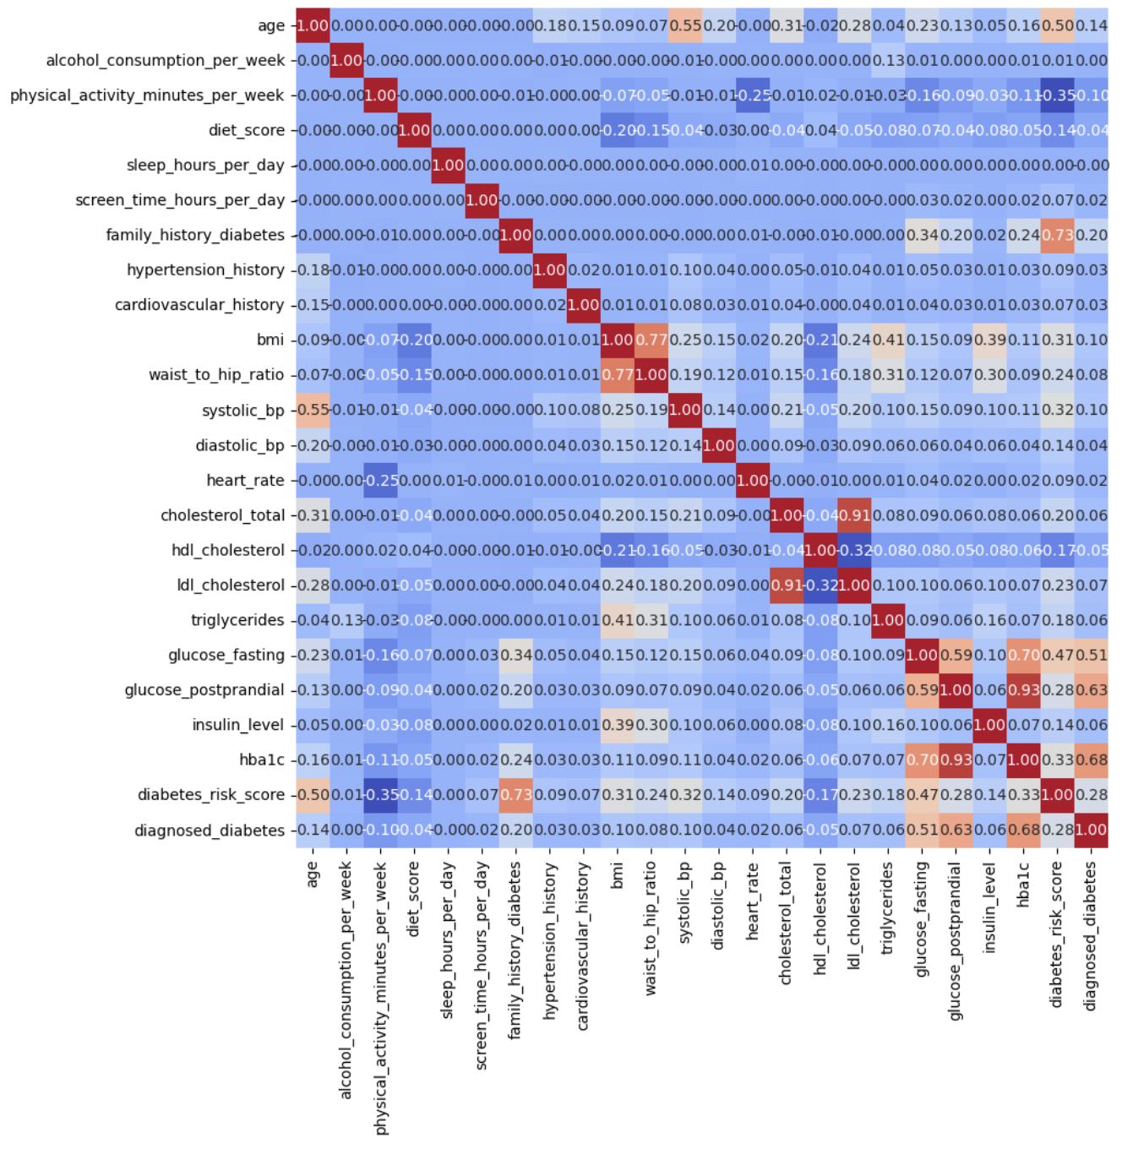
Exploratory data analysis: correlation heatmap
Observations:
Strong positive relationship between hba1c and glucose-postprandial/glucose-fasting
Strong positive relationship between ldl_cholestrol and cholestrol_total
Strong positive relationship between BMI and waist_to_hip_ratio
Strong positive relationship between diabetes risk score and glucose fasting/family-history diabetes/age

Slide 8
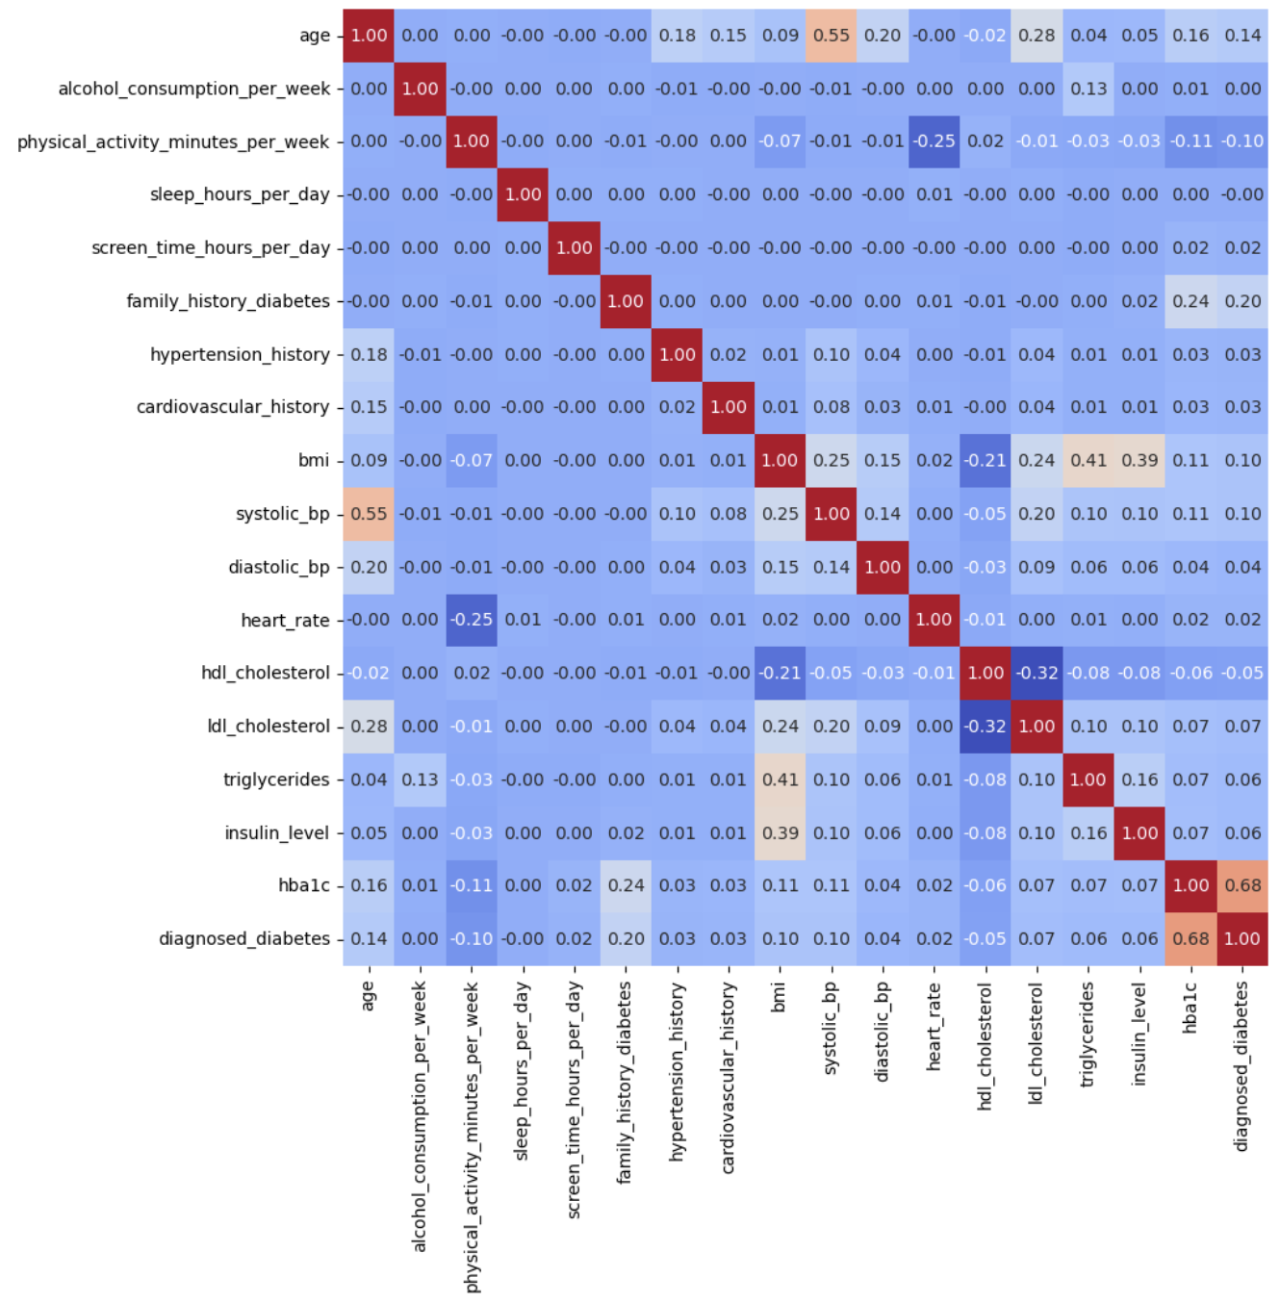
Multicollinearity in data
Multicollinearity occurs when two or more predictor variables are closely related, this can make the machine learning model less reliable.
To avoid this a few columns were removed:
Diabetic risk score
Diabetes stage
Cholesterol total
Waist to hip ratio
Glucose postprandial
Glucose fasting
The diet score column was also removed. This is a ‘subjective’ column and could skew the final result unfairly.

Slide 9

Part 2:
Model building and testing
Notes:
Image [5]- sourced from https://unsplash.com/

Slide 10
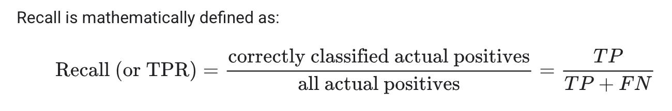
Evaluation metrics: testing validity of my models
I used the ‘recall’ metric to check the reliability of the models
Recall (sensitivity/ true positive rate) is a “metric that measures the ability of a model to correctly identify all the relevant instances”[1]
In medical ML models, missing a positive case (false negative) is more serious than incorrectly flagging someone as positive for a disease (false positive)
Why use eval metrics?
Provide model performance insights (data quality, correctness, error types, bias)
Assess models reliability
Allows fair comparison of different model types
Helps to inform hyperparameter tuning process
Identifies model limitations
Notes:
Reference:
[3] https://coralogix.com/ai-blog/recall-a-key-metric-for-evaluating-model-performance/
Image [6] sourced from same link (https://coralogix.com/ai-blog/recall-a-key-metric-for-evaluating-model-performance/)

Slide 11
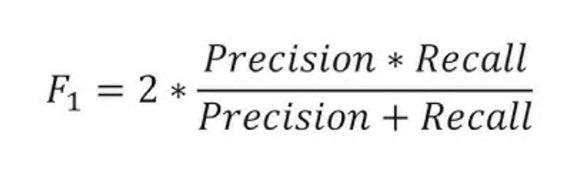
Evaluation metrics: testing validity of my models
F1 : the harmonic mean of the precision and recall score in a classification model.
Both scores contribute equally to indicate a reliability of a model.
F1 score | Interpretation
> 0.9 | Very good
0.8 - 0.9 | Good
0.5 - 0.8 | Ok
< 0.5 | Not good
Notes:
Reference:
[3] https://coralogix.com/ai-blog/recall-a-key-metric-for-evaluating-model-performance/
Image [6] sourced from same link (https://coralogix.com/ai-blog/recall-a-key-metric-for-evaluating-model-performance/)

Slide 12
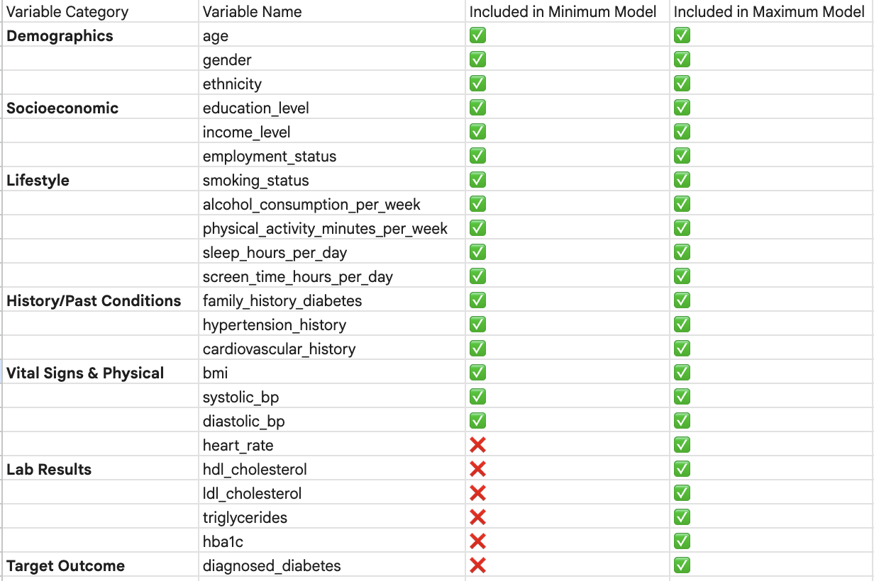
Two models:
minimum and maximum

Slide 13
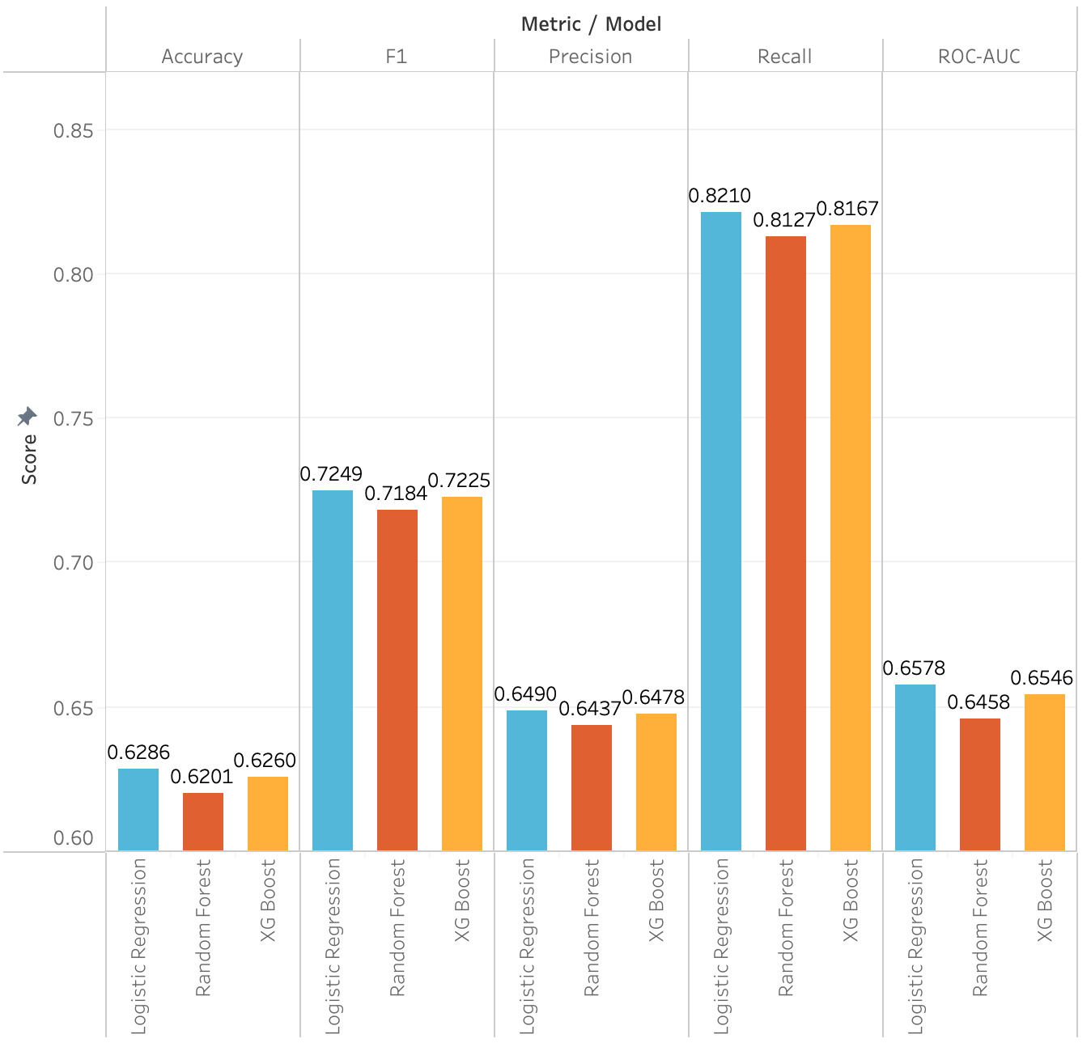
‘Minimum’ model metric scores
Before parameter fine tuning
LR model outperforms RF + XGBoost in all classification metrics

Slide 14
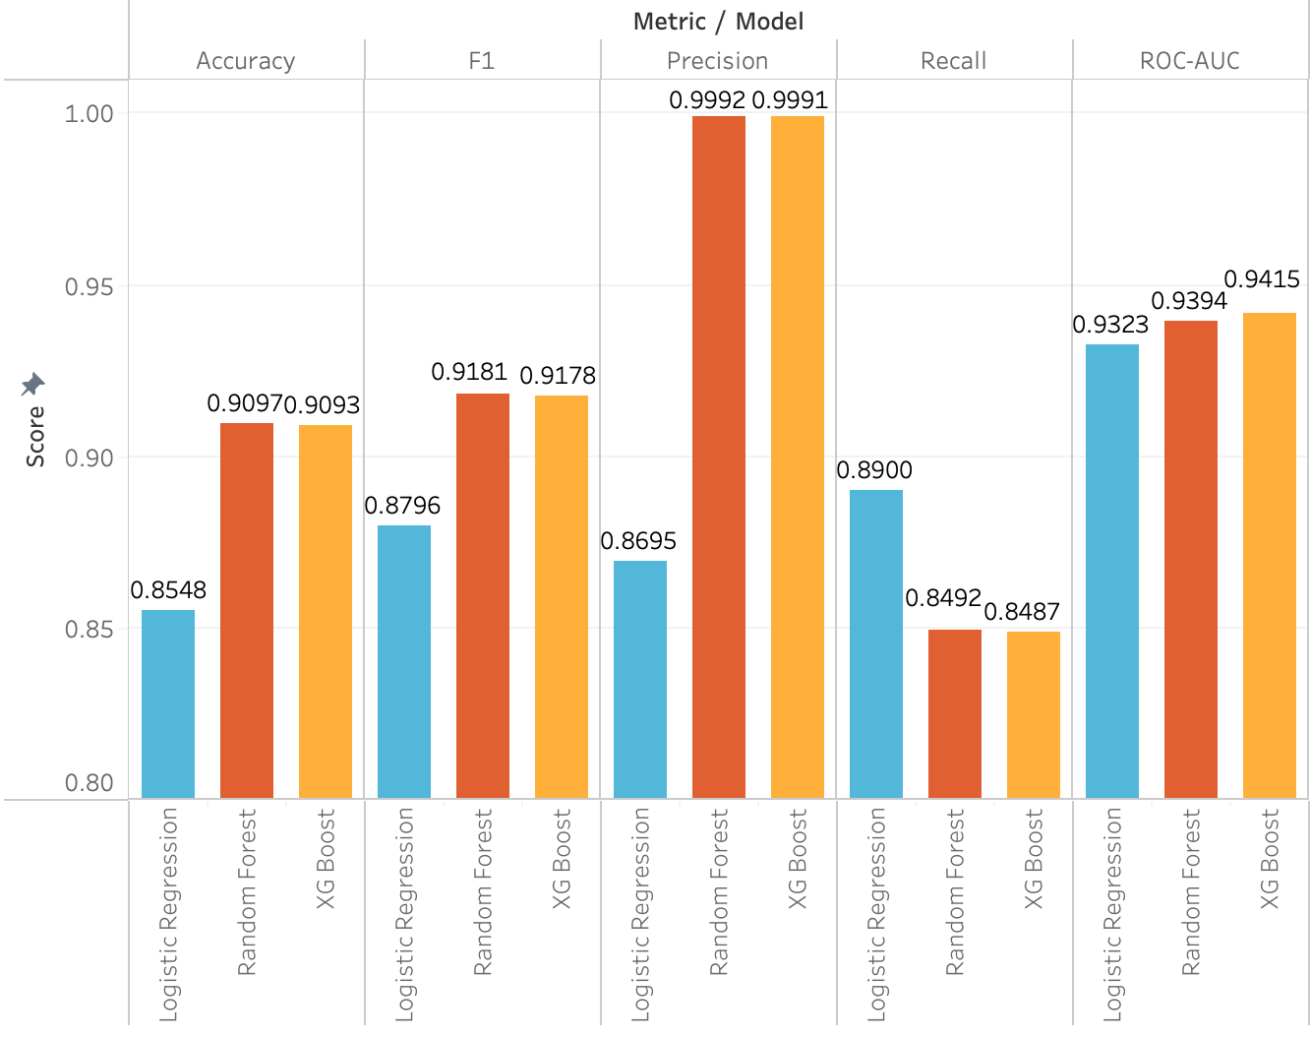
‘Maximum’ model metric scores
Before parameter fine tuning
LR model outperforms RF + XGBoost in recall
RF + XGBoost outperforms in all other categories

Slide 15
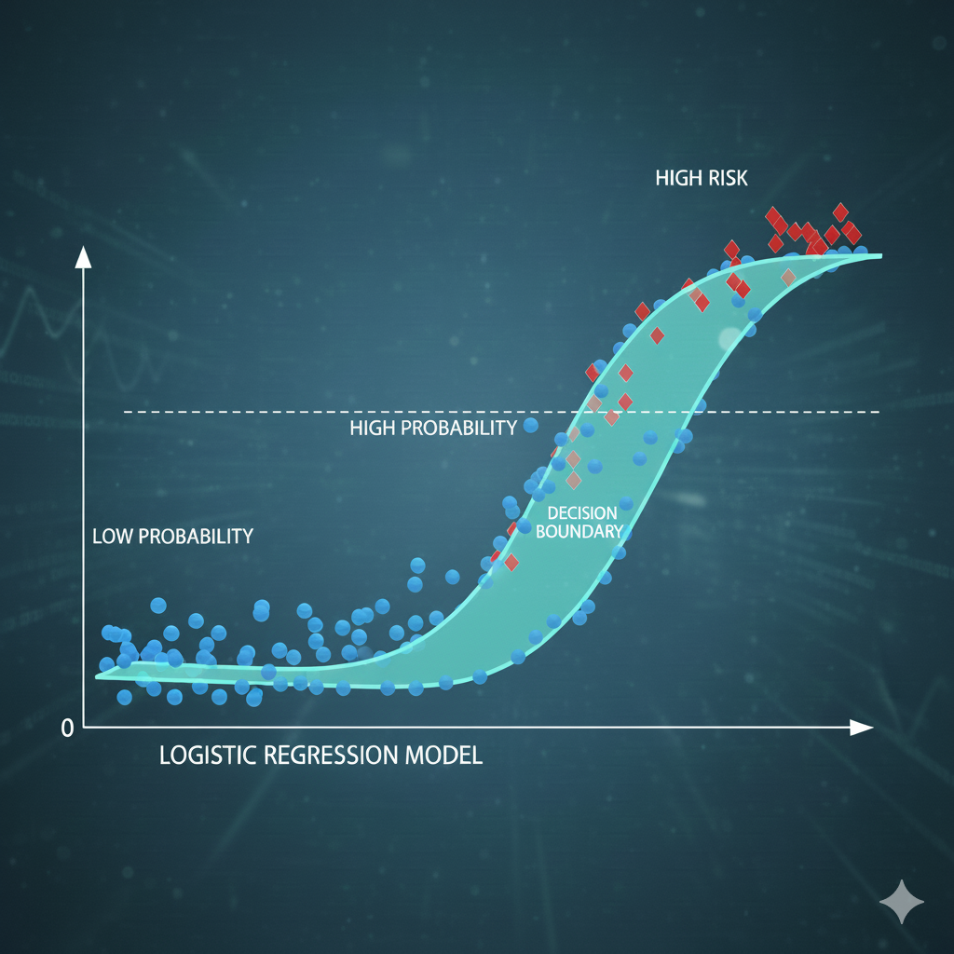
The winner… logistic regression!
The LR model was optimised by tuning the parameters - this was done using GridSearchCV
One of the most important areas to consider was the threshold (this determines the class label of the prediction)
The default threshold is usually 0.5 (the prediction is classified as ‘diabetic’ if the probability is greater than or equal to the threshold)
One way of improving recall was to lower the threshold but lowering the threshold also reduced precision

Slide 16
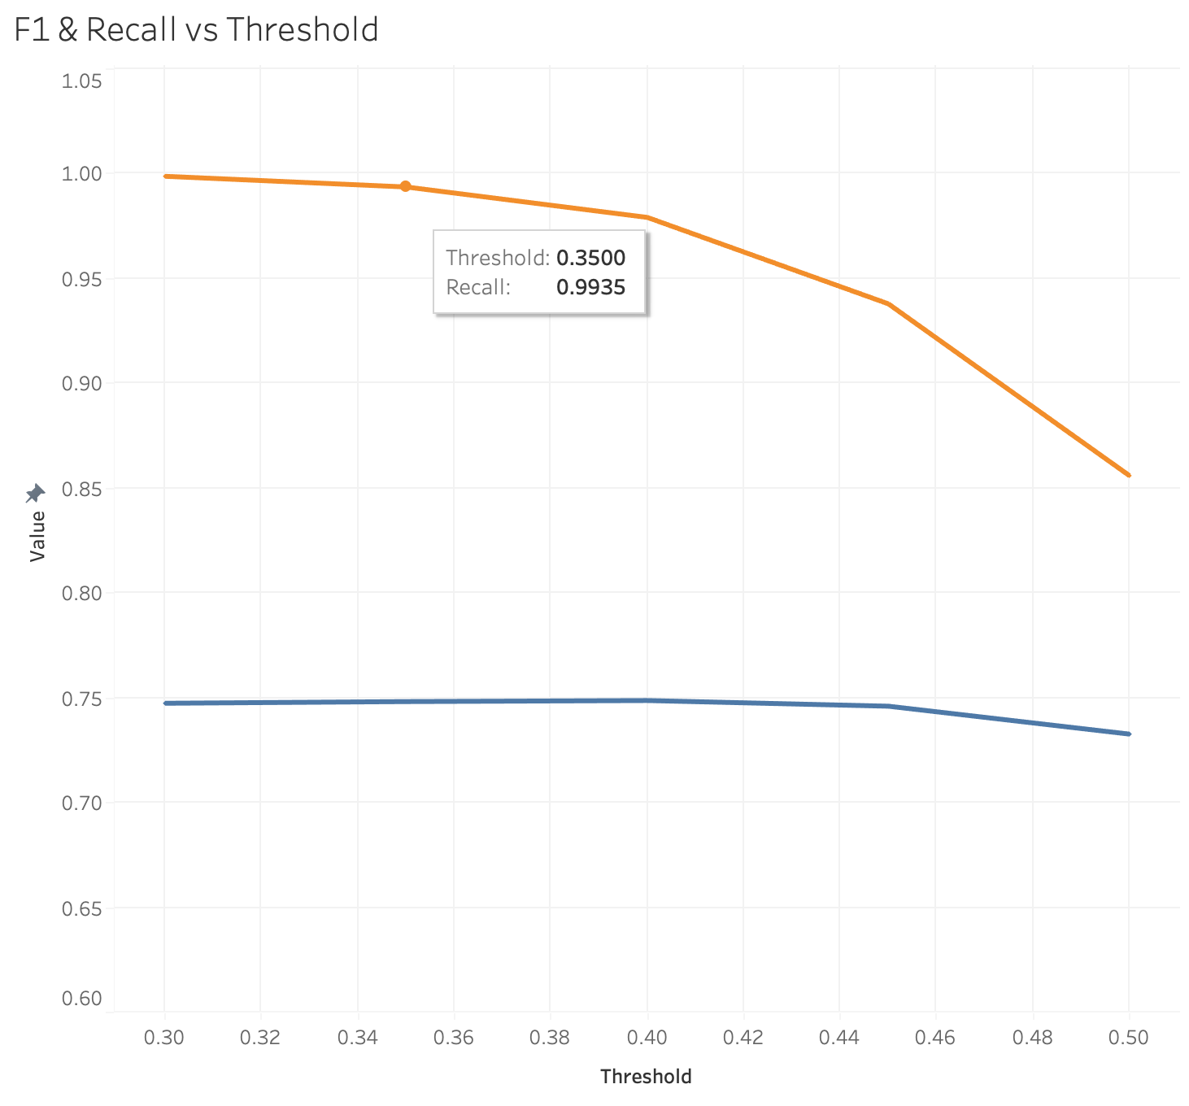

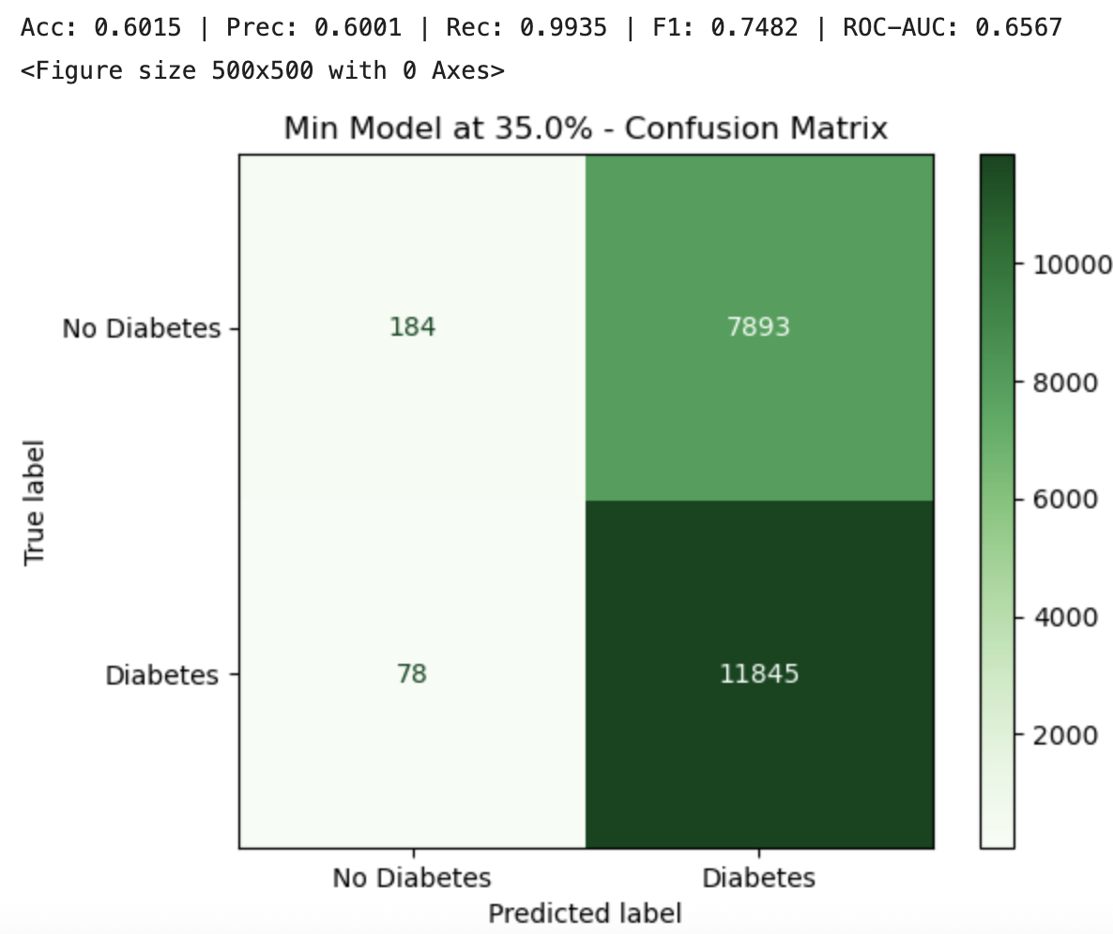
Fine tuned min model

Slide 17
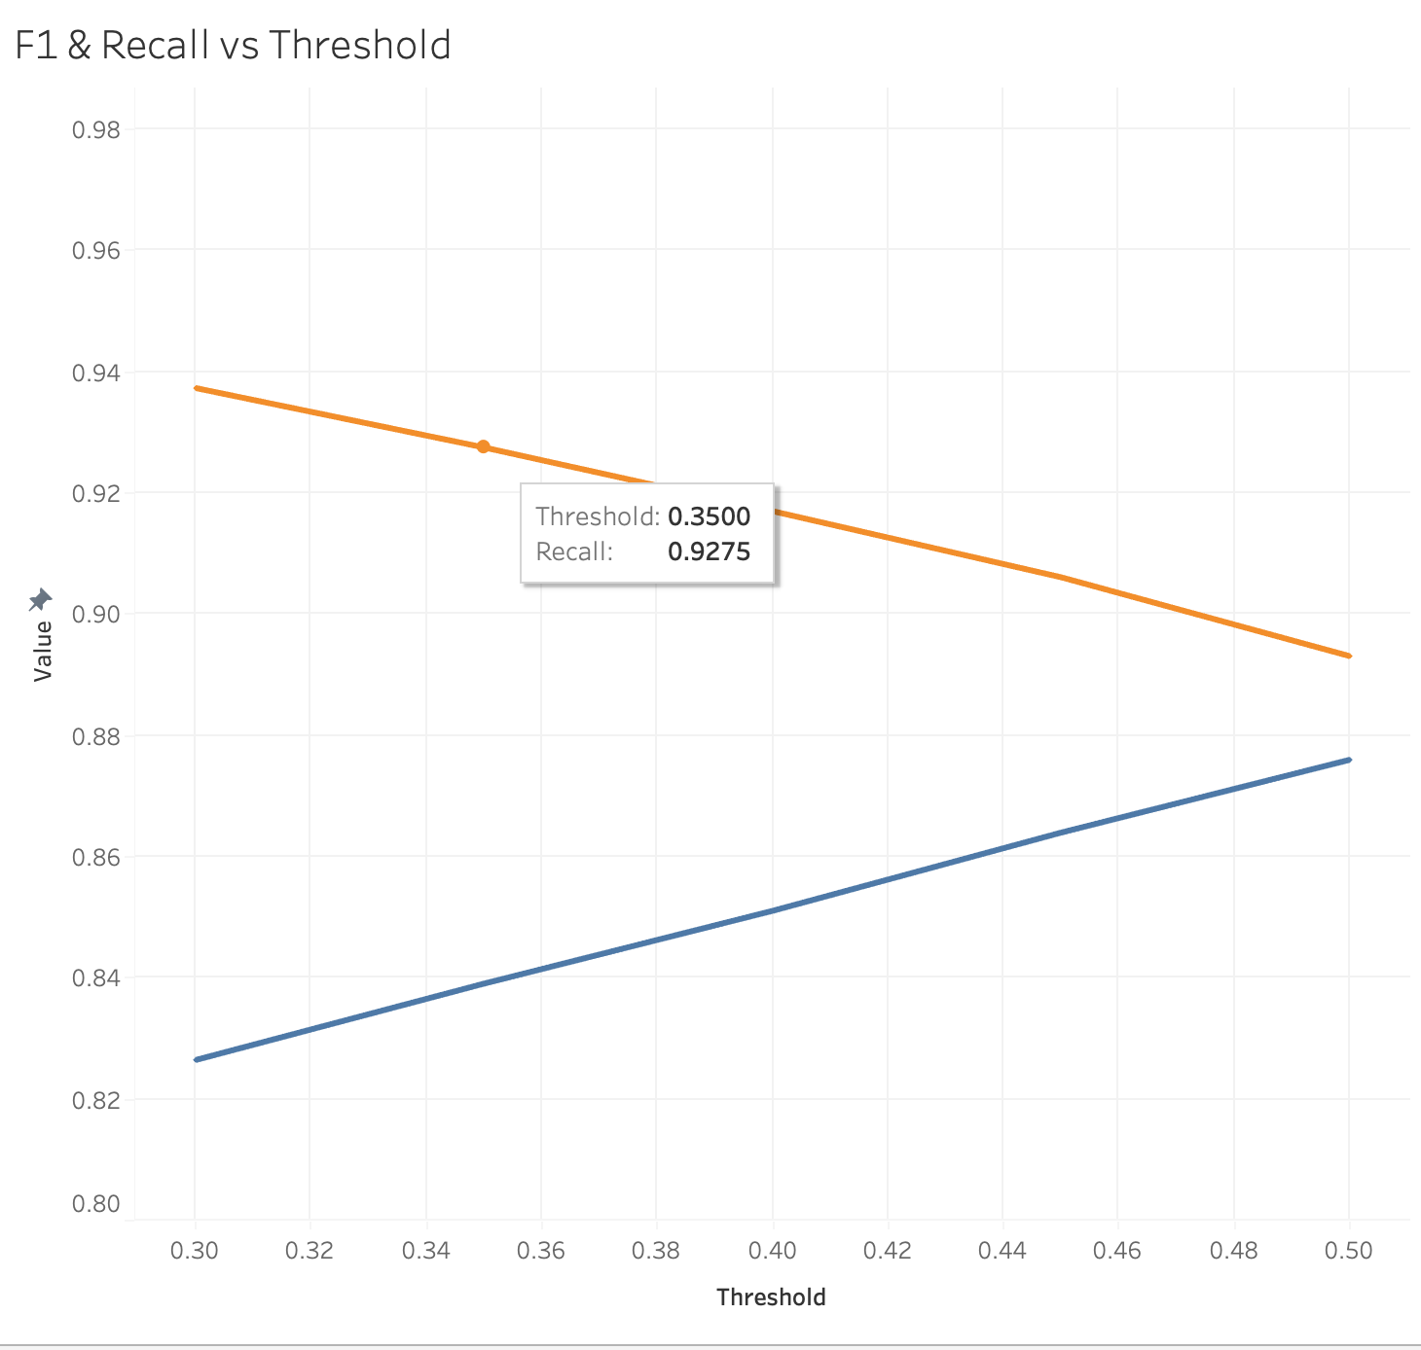
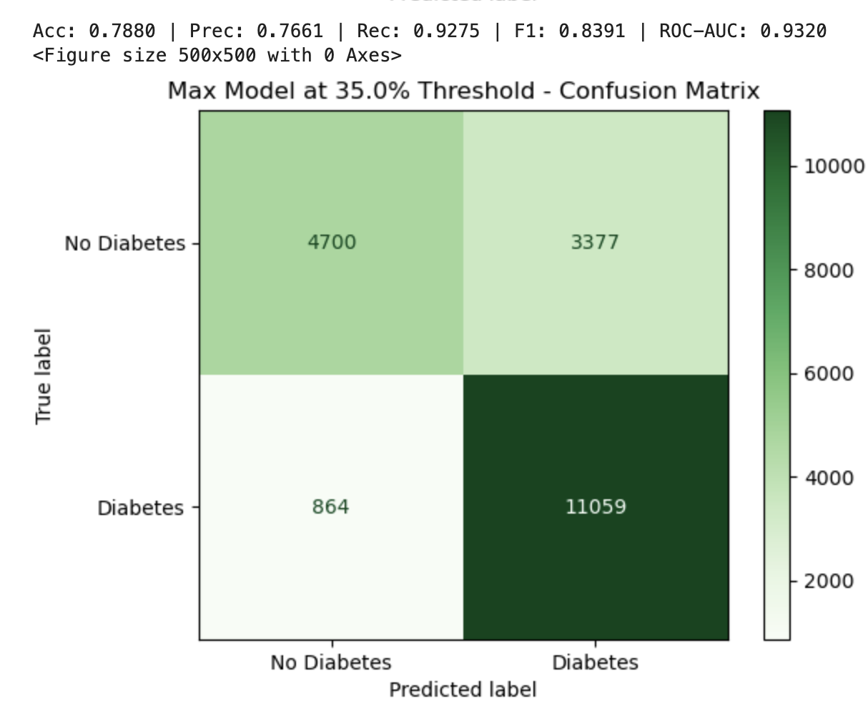
Fine tuned max model

Slide 18
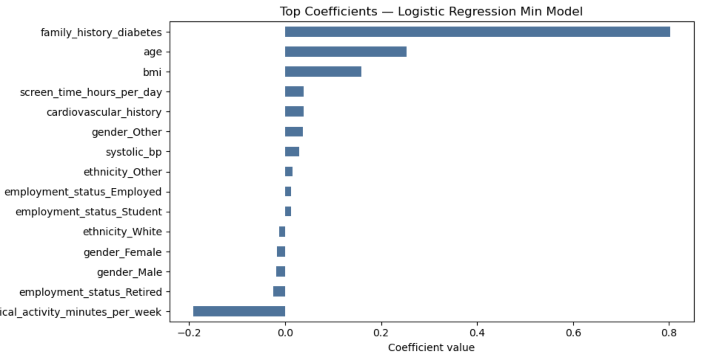
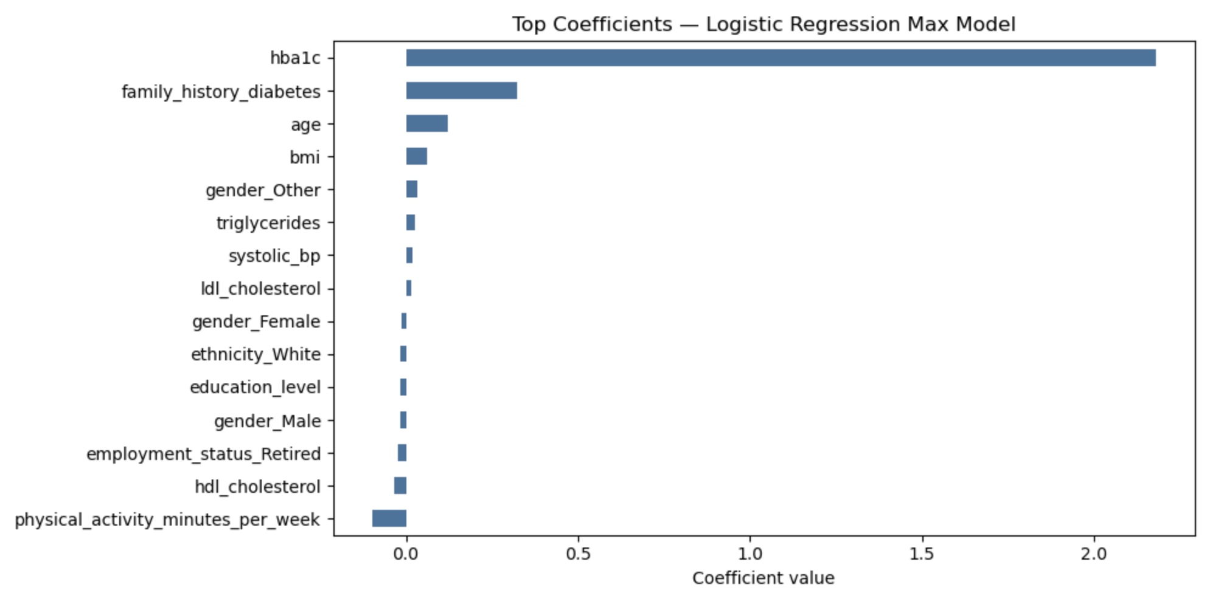
Feature importance
Min model:
Top features were family history of diabetes and age
Max model:
Top features were HBA1C and family history of diabetes
Physical activity appears as a negative coefficient in both models.

Slide 19

Part 3:
Demo
Notes:
Image [7]- sourced from https://unsplash.com/

Slide 20
Limitations and future improvements
Some important variables not included (e.g. medication history)
Logistic regression model may not pick up complex relationships between certain variables (biological relationships aren’t linear)
Use some real world patient information to check validity of models
Explore other advanced ML models
Conduct a sensitivity analysis on the features
Display recommendation advice on app if at risk of diabetes i.e. based of user behaviours, can increase exercise / reduce bodyweight

Slide 21
Q&A
?

